Slide 1
Working with the Web Part Property Pane
Introducing the Property Pane
Notes:
This module will introduce you to leveraging the property pane for client-side web parts created with the SharePoint Framework.

Slide 2

Introducing the Property Pane
Overview of Web Part property pane
Implementing custom properties
Notes:
In this unit, you'll learn how to use the property pane in your SharePoint Framework client-side web part components.

Slide 3
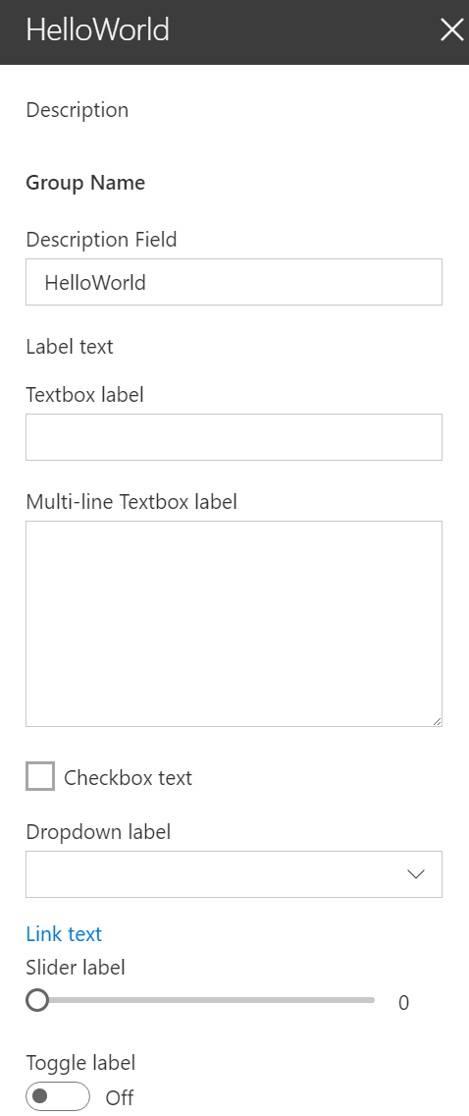
Overview
The property pane has three key elements
Pages, Headers, Groups
Property panes must contain a page and at least one group, the header is optional
The property pane supports the following field types
Label
Textbox
Multi-line Textbox
Checkbox
Dropdown
Link
Slider
Toggle
Custom
Notes:
The property pane has three key elements: pages, headers and groups.
A page is the entire visible panel of the property pane shown in the on the task pane.
The header is an optional section at the top of the property pane. It includes a description that you can set from the web part's code.
Each page on the property contains one or more groups. Groups contain one or more field controls used to display or collect information from the user.
We can have different groups that contain different fields and that allows us to group things within a specific page.
The SharePoint Framework API includes the following property pane field controls you can use in your custom web parts:
- label
- textbox
- checkbox
- dropdown
- link
- slider
- toggle
The label control is used to display text, while the other controls are used as form controls for the user to modify the public properties on the web part.
Developers can also create custom property pane field controls, or use third-party controls, when one of the existing controls doesn't meet the business business requirements.

Slide 4
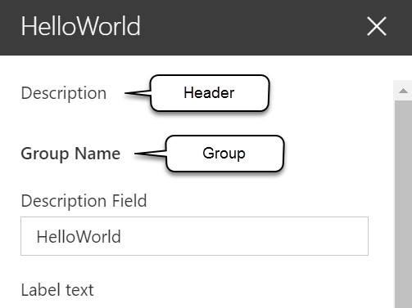
Implementing the header, groups, and fields
protected get getPropertyPaneConfiguration(): IPropertyPaneConfiguration {
return {
pages: [
{
header: {
description: strings.PropertyPaneDescription
},
groups: [
{
groupName: strings.BasicGroupName,
groupFields: [
PropertyPaneTextField('description', {
label: strings.DescriptionFieldLabel
}),
PropertyPaneLabel('labelField', {
text: 'Label text'
})
]
}
]
}
]
};
}
Notes:
The property pane is defined by your web part using a specific method. The SharePoint Framework will call the `getPropertyPaneConfiguration()` method on your web part to retrieve an object that implements the `IPropertyPaneConfiguration` interface.
The returned object contains a single property `pages` that returns an array of property pane pages:
Each page has an optional `header` property and a `groups` array. Each group can have a name and collection of fields assigned to it.
In the previous code, notice the single group has a name and a single text field control. This field control is mapped to the `description` property on the web part, defined in the web part's interface.

Slide 5
Implementing properties
Define an interface in your web part that includes one or more target properties
Import the corresponding field types in the web part class
Field types are available as modules in the @microsoft/sp-webpart-base library
Modify the default getPropertyPaneConfiguration method and add the properties to the groupFields array
Notes:
Let's look at how you can implement custom properties on your web part and enable users to modify their values using the property pane.
The first step is to define the web part interface that's created as part of the web part creation process. This interface is located in the same file as the web part class. These properties will be mapped to specific field controls in your property pane.
Next, you need to import the field control objects into your web part's class. These controls are located in the **@microsoft/sp-webpart-base** package.
The last step is to add controls to the `groupFields` array in a group for a page returned in the `getPropertyPaneConfiguration()` method. The first argument in each control's reference is the name of the property it maps to.

Slide 6
Handling property field changes
The property pane has two interaction modes:
Reactive
Non-reactive
Reactive mode: every change = change event is triggered
Reactive behavior automatically updates the web part user interface with the new property field values
Non-reactive mode: does not update the web part user interface automatically unless the user confirms the changes
While reactive mode is sufficient for many scenarios, at times you will need non-reactive behavior.
Notes:
The next step to customizing the property pane is to define how you want to handle changes to the properties in the property pane. The property pane has two different modes: **reactive** & **non-reactive**.
The default mode is reactive. In this mode, as you change the value of the property pane control, those changes are immediately applied live to the corresponding properties that they're attached to.
In the non-reactive mode, changes to field controls are not immediately applied to the associated property of the control. Instead, the user must select the **Apply** button at the bottom of the property pane that is only rendered when the web part's property pane is in non-reactive mode.
> [!NOTE]
> The non-reactive mode of client-side web part property panes matches how legacy server-side web part property panes worked.

Slide 7

Property pane modes
Default mode = reactive mode
Override the default behavior by adding the disableReactivePropertyChanges method to the web part class
Notes:
To change the property pane from the default reactive mode to be non-reactive, you'll override a property on the web part's base class: `disableReactivePropertyChanges`. This property is set to `false` by default, but overriding it to return `true` will set the property pane to non-reactive.

Slide 8
Adding configuration properties to React Client-Side web parts
Modify the propertyPaneSettings method and add the property to the groupFields array
protected get propertyPaneSettings(): IPropertyPaneSettings {
return {
pages: [
{
header: {
description: strings.PropertyPaneDescription
},
groups: [
{
groupName: strings.BasicGroupName,
groupFields: [
PropertyPaneTextField('description', {
label: strings.DescriptionFieldLabel
}),
Notes:
In the case where you're using React to implement client-side web parts, you'll likely want to handle the case when properties are changed if you're using the web part's properties in the React control.

Slide 9
Adding configuration properties to React Client-Side web parts
Pass the property value to React component when the React component is created
public render(): void {
const element: React.ReactElement<IHelloWorldWebPartProps> = React.createElement(HelloWorldComponent, {
description: this.properties.description
});
ReactDom.render(element, this.domElement);
}
Notes:
Let's start with a simple React client-side web part. The properties on the web part, in this case the `description` property is set on the public property of the React control.

Slide 10
Adding configuration properties to React Client-Side web parts
Handle the property values in the React component when the component starts and whenever the property value is updated
public componentDidMount(): void {
this.doSomething(this.props.description);
}
public componentDidUpdate(prevProps: IHelloWorldWebPartProps, prevState: IHelloWorldWebPartState): void {
if (this.props.description !== prevProps.description) {
this.doSomething(this.props.description);
}
}
private doSomething(description: string): void {
// Do something with the property
}
Notes:
Within the React control, implement two React lifecycle event handlers. The method `componentDidMount()` is called when the control is initially loaded on the page, while the `componentDidUpdate()` is called when the properties on the component change. In this case, both methods will call the `doSomething()` method that will handle the property's value:

Slide 11
Demo Working with the web part property pane

Slide 12

Summary
Overview of Web Part property pane
Implementing custom properties

Slide 13
Reading further
Overview of the SharePoint Framework
https://docs.microsoft.com/sharepoint/dev/spfx/sharepoint-framework-overview
Make your SharePoint client-side web part configurable
https://docs.microsoft.com/sharepoint/dev/spfx/web-parts/basics/integrate-with-property-pane
Validate Properties
https://docs.microsoft.com/sharepoint/dev/spfx/web-parts/guidance/validate-web-part-property-values

Slide 14
Thank you.

